Slide 1


IPL Data Analysis using python &EDA
Presented By ASHOK KUMAR GUAL
Notes:
By ASHOK KUMAR GUAL

Slide 2
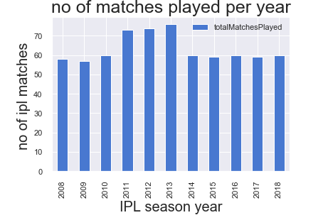
How many matches has been played in each season ?

Slide 3
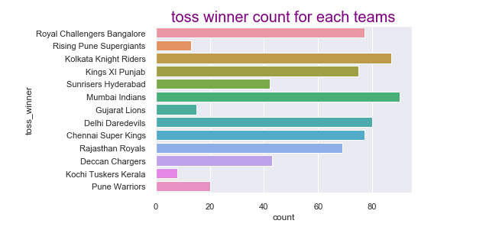
which team has won the max no of toss ?

Slide 4
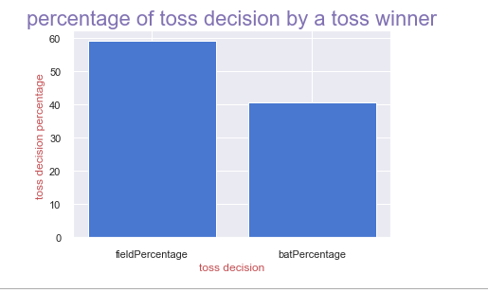
ratio of toss decision i,e bat first or bowl first by toss winner

Slide 5
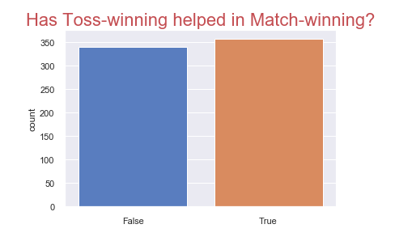
Impact of toss win on match result
False 48.706897 True 51.293103

Slide 6
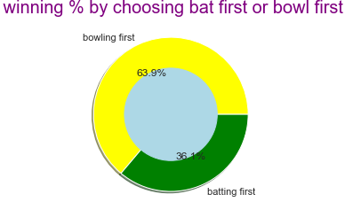

Slide 7
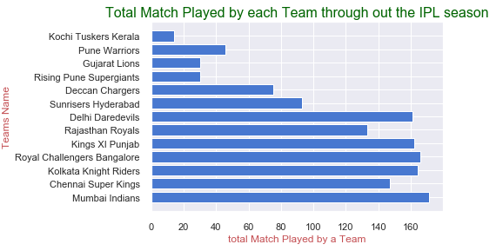
No of matches played by each team through out the season

Slide 8
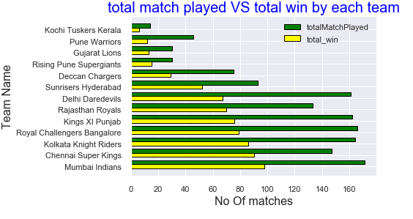

Slide 9
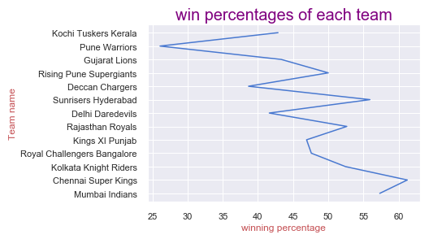

Slide 10
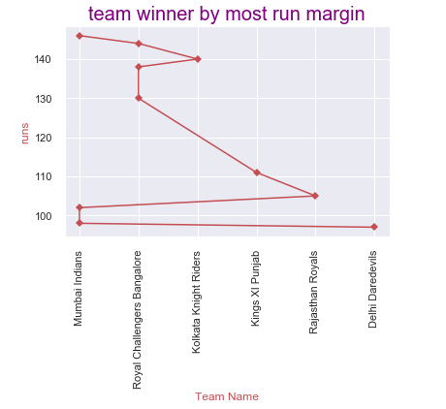

Slide 11
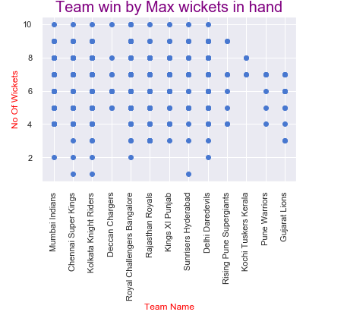

Slide 12
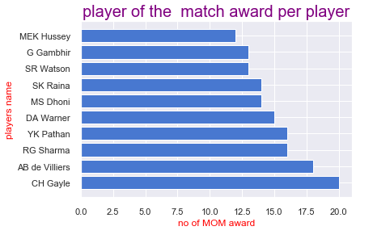

Slide 13
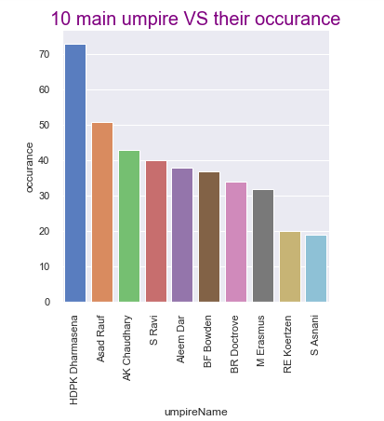
Top 10 main umpire appearances in IPL matches

Slide 14
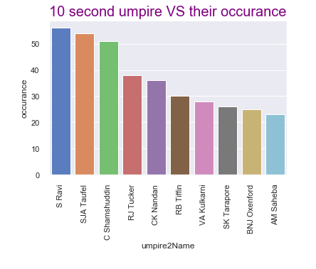
Top 10 2nd umpire apperances in IPL

Slide 15
Q & A Thank You

